Slide 1

Introducing IBM Watson Data Platform & Data Science Experience — October 2017
Notes:
Introduce self

Slide 2
Agenda
Why do companies struggle to deliver value?
Introducing Watson Data Platform
Services of the Integrated Platform
Lab
Notes:
The context of and need for an integrated analytics platform
Introducing WDP
Overview of core services
Current customers and real use cases
Summary & Conclusion, Q&A

Slide 3
Why do companies struggle to deliver value?
Data
Governance
Data resides in silos
Detailed data was never stored
Unstructured and external data wasn’t considered
Difficult to access
If the data isn’t secure, self-service isn’t a reality
Understanding lineage and getting to a system of truth
Skills
Infrastructure
Data Science skills are in low supply and high demand
Nurturing new data professionals is challenging
Need an environment that enables a “fail fast” approach
Discrete tools present barriers to progress
Notes:
All 4 of these areas need to be addressed!
Data: Most critical asset is not always available or even stored
Governance: Simply put, governance is important because data assets need to be trusted and validated before self-service can work properly
Skills: How to address the skill gap that exists for advanced analytics?
Infrastructure: Discrete tools and environments puts friction in the way of people and projects, slowing down innovation can easily blunt the effectiveness of the best teams.

Slide 4






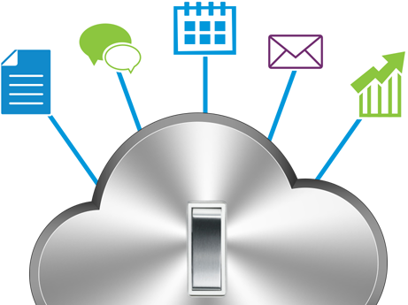
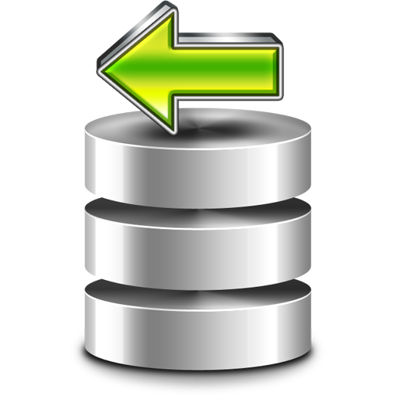
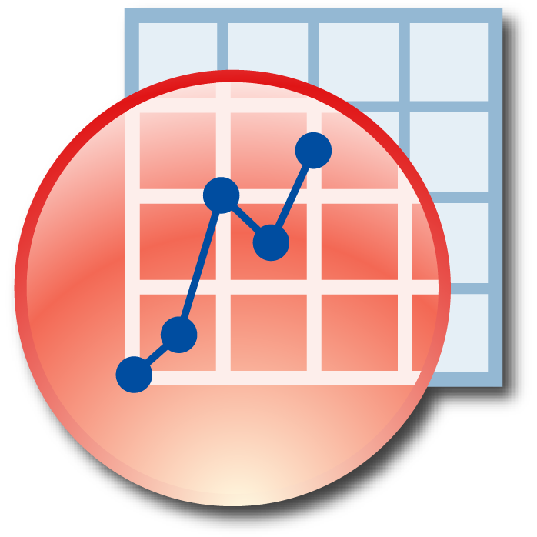

Turning Data into Insights is a Team Sport
Watson Data Platform
Data steward
Data scientist
Data engineer
Business Analyst
Developer
Clearly Articulate Use Case
Gather all the Data
Prepare Data
Digital
Application
Apply Machine Learning
Evaluate
Notes:
It requires a team of people to build quality data products
Not only that, but they each play a part in the execution of the workflow you see here
Take note of the flow here because these are the steps that I followed when building this solution
I built this solution mostly by myself, but figuratively speaking I had to wear many hats
[articulate the flow with personas]

Slide 5
Services of the Integrated Platform
Watson Data Platform
Self Service Experiences
Watson Analytics
Smart discovery & exploration
Data Science
Experience
Collaborative data science
Data Refinery
Data preparation & integration
Watson APIs
NLU, Personality Insights, Visual Recognition, etc.
Data Catalog
Data & analytical asset organization
with governance
Data Movement and Processing
Lift
Grount-to-cloud transfer
Analytics Engine
Hadoop & Spark
Watson Machine Learning
ML processing & management
Message Hub
Kafka
Streaming Analytics
Analytics for data-in-motion
Data
Object Storage
Redis
Graph
Mongo
Cloudant
Postgres
DB2 on Cloud
DB2 Warehouse
on Cloud
…
Notes:
Let’s spend a moment on this slide - this is how the different pieces of watson data platform are logically related to eachother, and you can think of this as your “solution architecture” slide
At the bottom layer underpinning everything is data, and WDP supports integration with a broad set of structured and unstructured sources
In the next layer is how we treat data that’s in motion – moving through applications or to and from repositories
Above this is the ‘experiences’ layer, where we have software designed for specific personas on the advanced analytics team
So, WA for the business analyst, DSX for the data scientist, and so on.
Finally, tying it all together is the data catalog on the right. This is the technology that allows for the indexing and governance of data & assets as they flow through the platform.
I’ve highlighted the services I’ve used in green
The data was in Object Storage
I deployed and manage one of my models in WML – when users interact with my application the data is sent to WML, scored, and a prediction is returned and rendered to the user.
I wrote my code and built out my project in DSX
And finally I leveraged Watson APIs in my code to infuse the digital application with our cognitive secret sauce.

Slide 6

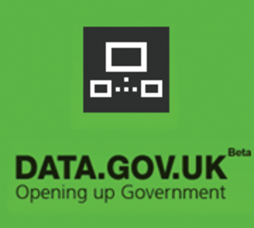


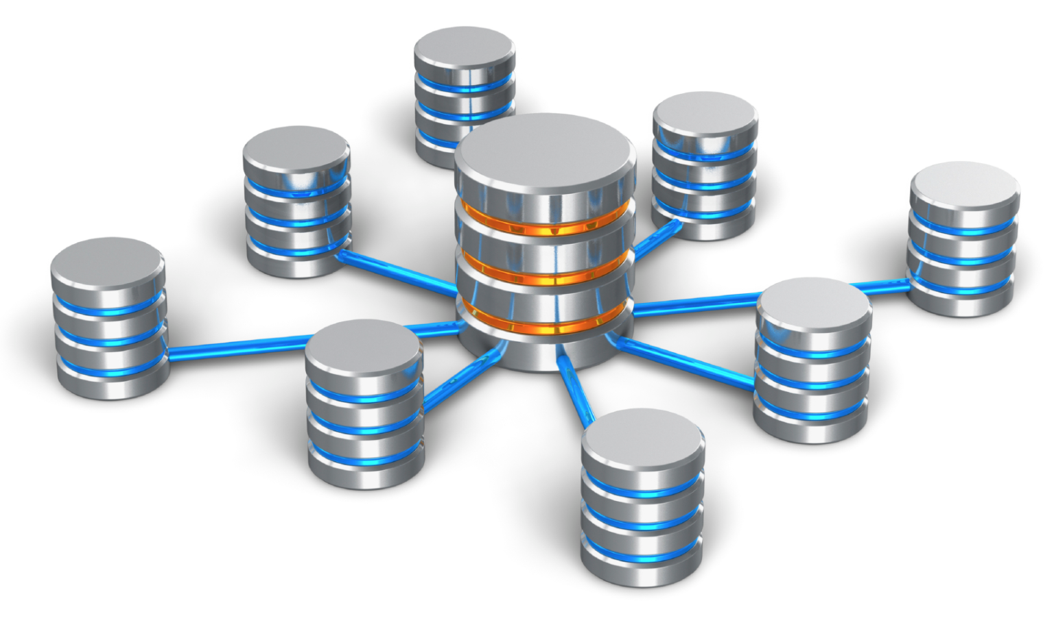


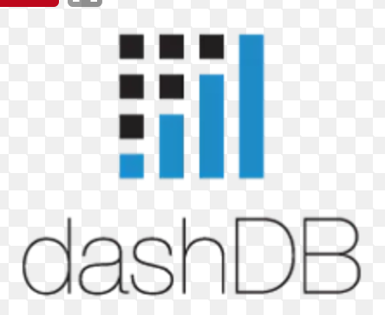




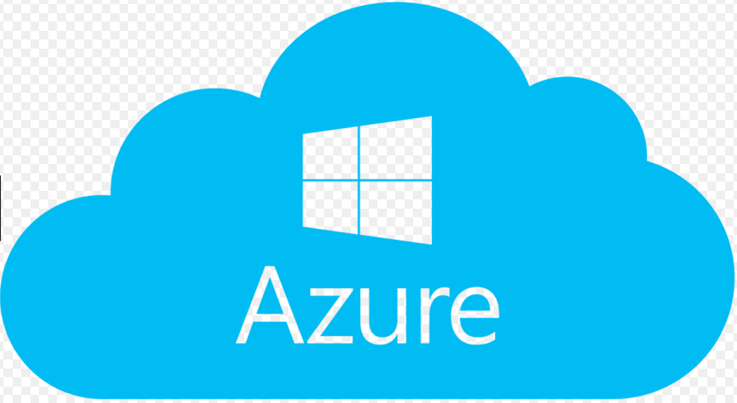



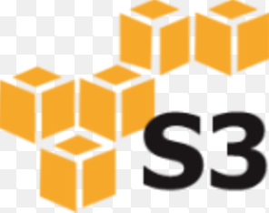



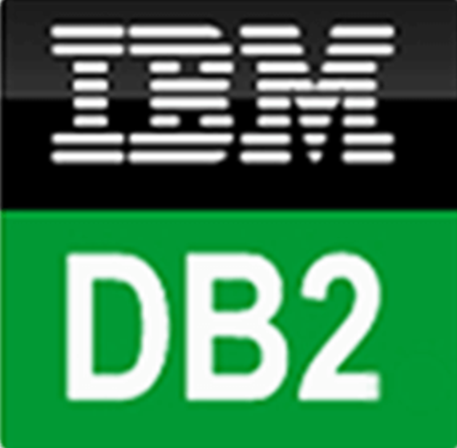
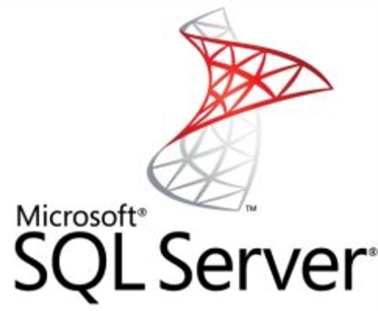
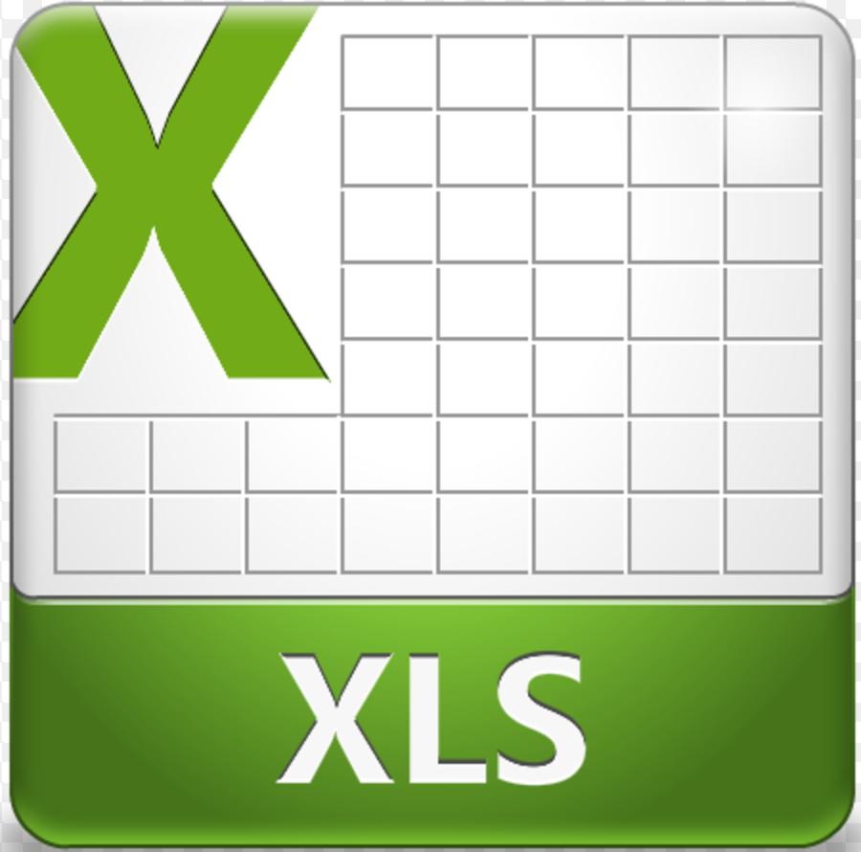


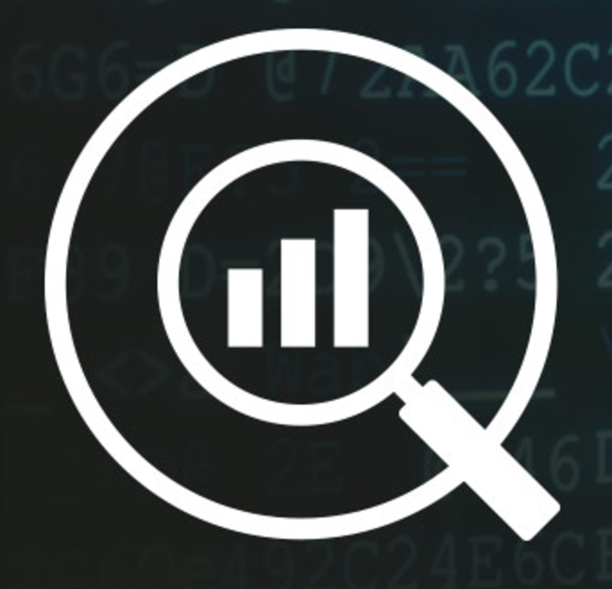
Intelligent Metadata Index
Providing 360 view of all data for all users
Data can reside in original systems, but users can discover it quicker to join together for smarter analytics
Data lake
Open Data
Classification
Data steward
Data scientist
Data engineer
Business Analyst
Developer
Classification
Governance as a Service
Data warehouse
Data Catalog
Social Data
Metadata Index
Cloud sources
UI’s
Collaboration
Sensor Data
Enforcement
Monitoring
Glossary
Policies
Rules
Classifiers
On Prem sources
Machine Leaning
Dark data
Notes:
- Key point here is that all manner of data – structured and unstructured – is indexed by the catalog and governed by policies. When data is requested the index is used to find it and retrieve it.

Slide 7
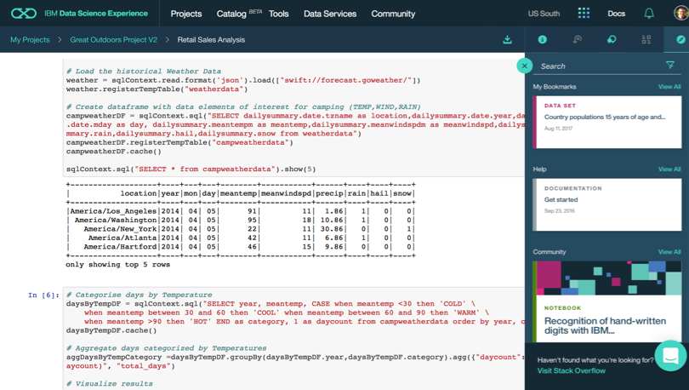
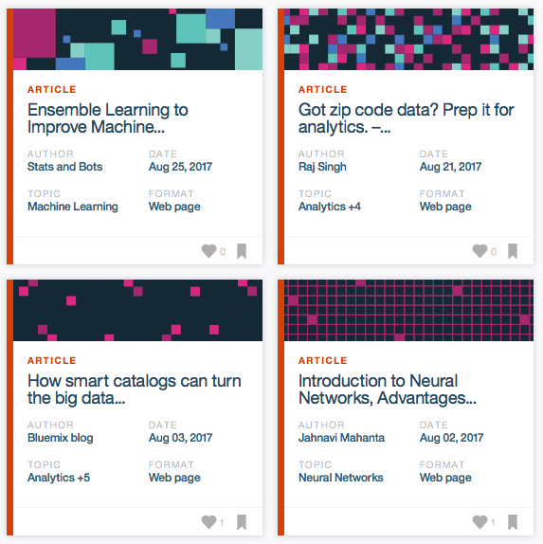
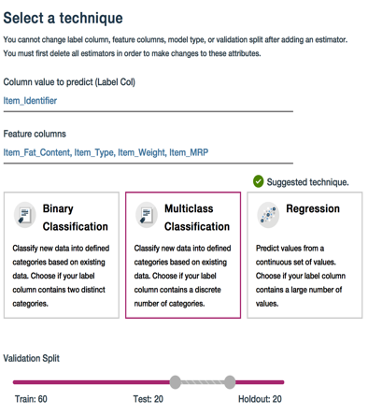
Watson Data Platform
Data Science Experience
Making data science a team sport
Learn
Built-in learning to get started or go the distance with advanced tutorials
Create
The best of open source and IBM value-add to create state-of-the-art data products
Collaborate
Community and social features that provide meaningful collaboration
Notes:
Now let’s dig into the IBM Data Science Experience (DSX).
- DSX is a single place to Learn, Create, and Collaborate – the 3 pillars of a successful data science organization.
- With DSX we are making it easier for data scientists and data science teams to learn new skills and technologies in the fast moving data science profession.
- DSX provides freely available datasets, code samples, tutorials and articles from the data science community, making it easier for data scientists to learn in-context.
- We also know that a data science team isn’t going to standardize on a single technology or tool – data scientists need an open and integrated platform that brings all of their tools in one place.
- DSX brings together the best of open source such as RStudio, Spark, and Python in an integrated environment along with IBM value-adds, such as a managed Spark service and data shaping capabilities all in a secure and governed way.
- Users can collaborate in DSX with ease -- you can manage project assets and user collaboration through built-in social features for sharing, forking, and reusing assets. These built-in collaboration features can really help boost team productivity and managing projects across their lifecycle.

Slide 8
How does WDP help fulfill the promise of your data?
Watson Data Platform
Data
Governance
Puts every important data source at the fingertips of the teams that need it wherever resides
Enforces your policies without getting in the way of delivering insights
Skills
Infrastructure
Makes the most of the data professionals you have and helps them grow and learn from each other as a team
Delivers the foundation for your first data project through to the complete transformation of your business
Notes:
So, coming back to the challenges with companies transforming themselves with data.
Data: However challenging wrangling and refining your data is, Watson Data Platform helps reduce the effort and the time to put it at the fingertips of your data professionals
Governance: Not only does the platform deliver active learning implementation of your governance policies but it keeps it out of the way of delivering critical data insights
Skills: WDP helps you grow your data professionals, learning from each other and the community we help provide access to
Infrastructure: And finally the platform will grow with you. From your first data scientist on a single project through to your entire business. Adopt and grow at your own pace.

Slide 9
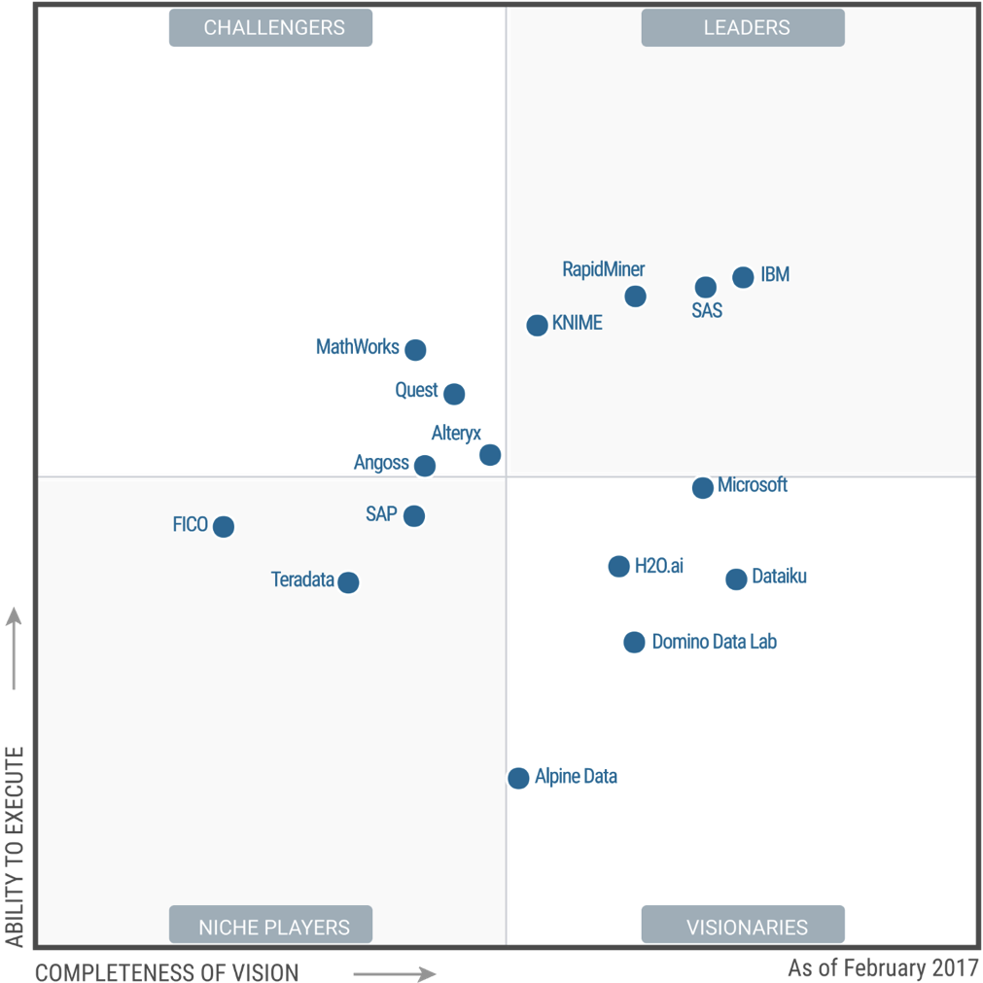
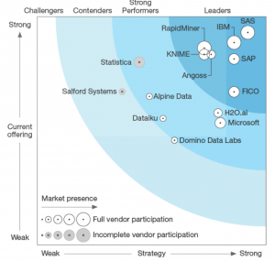
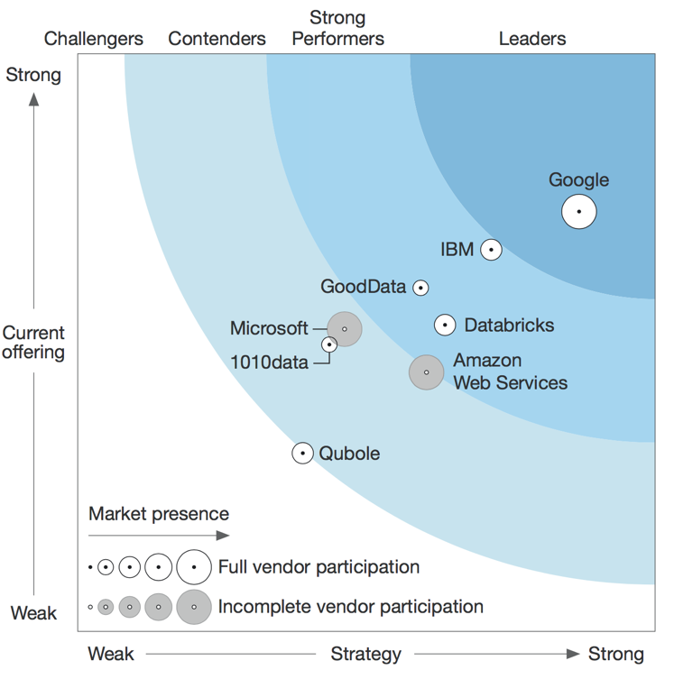
Finding Inefficiencies in Airbnb Markets – Playing to our Strengths
Gartner Magic Quadrant 2017
Data Science Platforms
Forrester Wave 2017
Predictive Analytics & Machine Learning
Forrester Wave 2017
Insight Platforms-As-A-Service
IBM is positioned as a Leader in the 2017 Gartner Magic Quadrant for Data Science Platforms, based on its ability to execute and completeness of vision.
IBM is positioned highest in execution and furthest in vision within the Leaders Quadrant.
This is the fourth consecutive year for IBM to be recognized as a leader in this report.
Source: https://www.gartner.com/doc/reprints?id=1-3TKD8OH&ct=170215&st=sb
http://www.developerweek.com/awards/2017-devies-award-winners/
Notes:
So then the biggest takeaway is that we can confidently tell our clients that IBM has built something special with WDP and DSX, something that enables their teams and organizations to be more effective and competitive. And as you can see the industry analysts validate what we believe internally, giving us recognition for Data Science, Machine Learning, and “Insight Platforms-As-A-Service”
I’ll conclude by saying that I am personally excited for the launch of WDP 2.0 next Thursday – I think the introduction of Data Catalog and the general maturation of DSX & WML are a winning combination, and hopefully this demo and the message it carries resonates with our clients. [next slide]

